Slide 1
Introduction
Many regions in the world do not have easy access to fresh drinking water
Desalination process helps remove salts from sea water to make it drinkable
Pros: Brings drinking water to many dry regions
Cons: Expensive
In some parts of Middle East, a liter of water is more expensive than a liter of gasoline

Slide 2

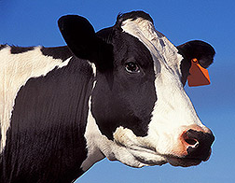
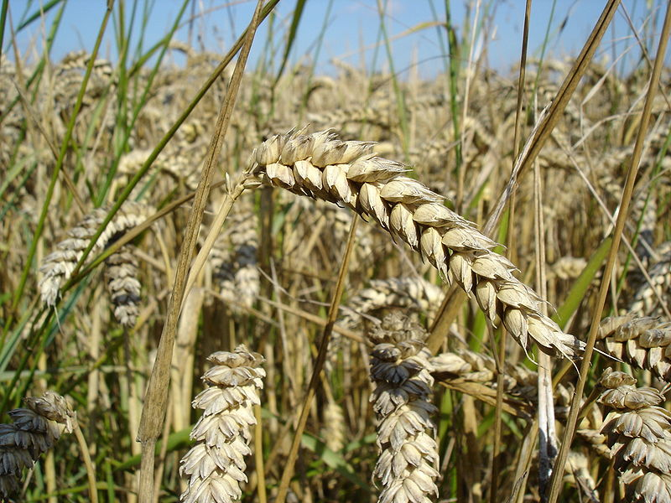
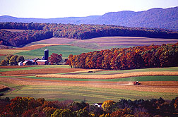
Fresh Water Needs
Economic expansion
Agriculture and food
Public health
Quality of life
Notes:
Scarcity of fresh water has serious implications.
It can slow or stop economic expansion, reduce agricultural output, hamper food independence, and degrade public health and quality of life.

Slide 3

Why Desalination?
75% of the Earth’s surface is covered by water
97.5% of that water is oceans
Only 1% is available for drinking
80 countries suffered from water scarcity by the mid-1990s
1.5 billion people lack ready access to drinking water
Notes:
Link takes you to a Water Desalination Module created by the General Electric Company
See: http://www.gewater.com/images/multimedia/desal/index_flash.html

Slide 4
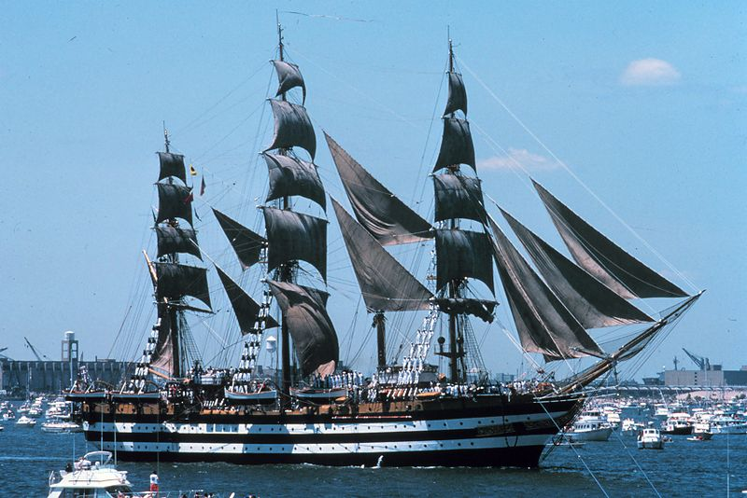
Can we drink salt water?
The Rime of the Ancient Mariner
Water, water, everywhere
And all the boards did shrink
Water, water, everywhere
Nor any drop to drink
-Samuel Taylor Coleridge
Small quantities are not harmful, but it is counterproductive (it just makes you more thirsty!)
Eventually, it can be dangerous, ultimately producing fatal seizures, heart arrhythmias and kidney failure
Notes:
Water, water, every where, Nor any drop to drink.
—Samuel Taylor Coleridge, The Rime of the Ancient Mariner, part II, stanza 9

Slide 5
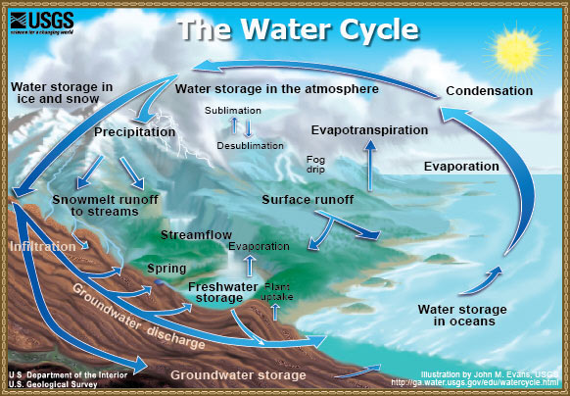
Natural Desalination: Water Cycle!
Major Stages
1. Evaporation
2. Condensation
3. Precipitation
4. Collection

Slide 6
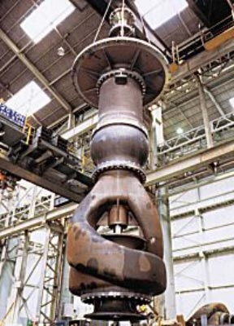
PROCEDURES
Reverse Osmosis
Distillation
Multistage flash (MSF)
Multiple effect distillation (MED)
Vapor compression
Electro dialysis
Vacuum freezing

Slide 7
drinking water
water
vapor
membrane
condenser
clean water
saltwater
vapor
evaporator
condenser
water
brine
evaporator
brine
brine
waste tank
Example: This plant uses two evaporators and condensers along with a membrane filter to clean saltwater (follow the arrows though the diagram)
Notes:
Evaporator: Takes in saltwater and produces vapor and brine
Condenser: Takes in vapor and produces water
Membrane: Takes in saltwater or water and produces a cleaner version of it
Clean water: a holding tank for the clean water
Waste tank: A place to collect all waste products

Slide 8
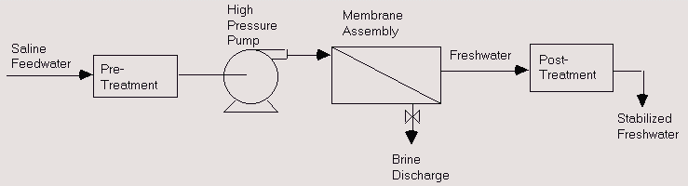
Reverse Osmosis
Water pressure increased
Pumped through permeable membranes
Salts separated from water due to membranes
Most desalination plants utilize this technology

Slide 9
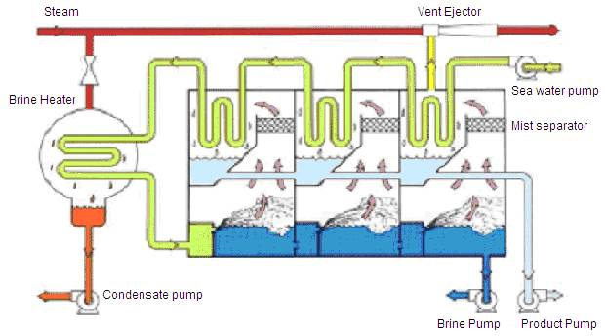
Multi Stage flash
Steam is used to heat tubes of saline water
Heated water flows into “stages” that are at lower pressure
Water boils rapidly and “flashes” into steam

Slide 10
Multi Stage flash (cont…)
Generally, only a small amount converts to steam since rapid vaporization results in cooling of water
Thus water is flashed multiple times in different stages at lower pressures, requiring no extra heat
But, multi stage flashing reduces thermal efficiency
85% of world’s desalinated water is generated through MSF
Recently the equipment has become cheaper

Slide 11
Desalination Technologies
Thermal Desalination Processes
Similar to the Earth’s natural water cycle
Water is heated, evaporated and collected
Produces clean water and brine
Example: Multi-Stage Flash Desalination
Process uses multiple boiling chambers kept at different atmospheric pressures
Saltwater enters the system and is boiled and evaporated in each chamber
Process produces clean water and brine

Slide 12
Desalination Technologies
Membrane Desalination Processes
Saltwater is forced through membrane sheets at high pressures
Membrane sheets are designed to catch salt ions
Process produces clean water and brine
Example: Reverse Osmosis
Saltwater is forced through a membrane at 600 to 1000 psi
Multiple layers of membranes remove as many of the salt ions as possible

Slide 13
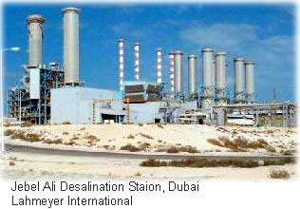
Desalination Plants around the World
Jabel Ali Desalination Station in Dubai
Capacity: 140 million gallons per day
Opened June 2010

Slide 14
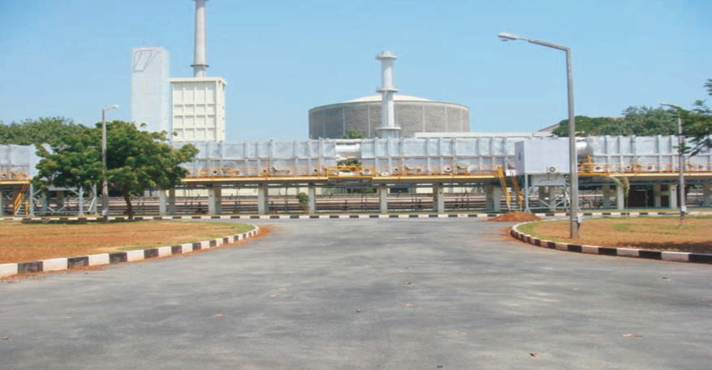
Nuclear Desalination Demonstration Plant (NDDP)
MSF-RO desalination plant of 6.3 million litres per day (MLD) capacity (4.5 MLD MSF
and 1.8 MLD RO)
It is the largest nuclear desalination plant based on hybrid technology in the world. MSF section is designed for high efficiency giving high Gain Output Ratio (GOR).
RO produces potable quality water. Product
water from MSF and RO can be blended to provide better quality drinking water.

Slide 15
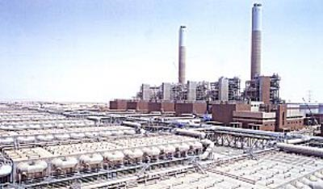
Shoaiba Desalination Plant
Largest desalination plant in the world
Produces 450,000 m³/day
Per year
150 million m³ of water is
desalinated
Total cost is $1.06 billion
To increase the thermal efficiency of this plant, the maximum number of stages is set to 25 (MSF)
Research in the field is resulting in more plants coming up in Florida and California

Slide 16
More Desalination Plants
Abu Dhabi, United Arab Emirates (3)
Aruba (1)
Australia (3 in use, 3 under construction, 1 planned)
Cyprus (1)
Israel (3 in use, 2 under construction)
USA
Yuma (Arizona), opened 1992
El Paso (Texas) opened 2004
Tampa Bay (Florida) opened 2007
Monterey (California), in the planning stages
Republic of Trinidad and Tobago (1)
Notes:
Source: http://en.wikipedia.org/wiki/Desalination > Existing facilities and facilities under construction

Slide 17
The end

